Slide 1
Lockton Complex Claims Referral Partners

Slide 2
What is the COD program?
Lockton Centers of Distinction
(COD) Program
Lockton has established streamlined direct referral relationships with some of the country's top institutions to facilitate reviews of cases where members appear to be having difficulty getting the right diagnoses and/or best-fit treatment recommendations. This program is specifically built for rare and complex conditions and should be viewed as complimentary to traditional Center of Excellence and second opinion programs our clients may have access to.
Why did we start this program?
Clinical inefficiencies lead to an estimated $27-378 billion in wasted healthcare dollars annually*
The Lockton complex claims team identified an opportunity to reduce excess cost and improve outcomes in highly complex clinical situations by opening access to world class subspecialists in niche areas to members in need on our clients’ health plans. By establishing a Lockton-wide program, we can make this opportunity available to clients across our book of business regardless of size and eliminate the need for client-specific contracts and processes. The result is a reduction in diagnostic delays and the elimination of unnecessary testing and ineffective therapies.
*American Journal of Public Health December 2020, Vol 110, No. 12

Slide 3
COD Program Overview (cont.)
Which members might qualify?
Every case is unique, and each program has different qualifications. Typically, members who qualify have very complex clinical situations (such as rare/multiple diagnoses or the need for multiple care specialists) who atypically utilize healthcare resources. These members are frequently high cost, or likely to become high cost, for the health plan. Examples include:
Mayo Clinic: frequent healthcare utilization, multiple comorbidities, rare diseases, chronic kidney disease, need for diagnosis confirmation and/or treatment plan recommendations from multiple specialties
Dana Farber: rare and complex cancers
Cleveland Clinic: need for diagnosis confirmation and/or treatment plan recommendations in a particular specialty
Is there a program cost tied to this?
The cost varies depending on whether the visit is conducted in person or virtually (Cleveland Clinic only), but most related program costs are paid as claims for physician visits and/or testing, if needed. Lockton will confirm in network status prior to referral.

Slide 4
Mayo Complex Care Program (CCP)

Slide 5
Mayo Complex Care Program (CCP)
What is the CCP?
Complex Care Program is a program for individual complex cases, who may benefit from specialist referral and/or care coordination, are identified and referred to Mayo by the Lockton Clinical Team.
Travel benefit coordinated with employer.
Who is eligible?
Members with:
Fragmented Care
High Utilizers
Multiple Comorbidities
Rare Diseases
Require assistance for diagnosis confirmation or treatment plan
Members under the age of 16 are required to go to Mayo Rochester site.
More than 1.3 million patients from the U.S. and over 142 countries worldwide choose mayo clinical each year. ¹
1. The Mayo Clinic.

Slide 6
Complex Care Program (CCP) Process
Pre-Mayo
Mayo Visit
Post-Mayo
Identification
Problem Solve
Follow Up
1.) Identification of Member
Lockton Identified – Clinical Consultant identifies during claim review process
Administrator Identified – Case Management team refers to Lockton
Employer Identified – HR
2.) Client decision on travel Coverage
3.) Member Outreach
Lockton or Administrator Case Management team reaches out to member to review program opportunity (will vary)
4.) Forms completed by Member
Authorization Form
Travel From
5.) Lockton enters Member Information and submits forms into Mayo Referral System
6.) Mayo contacts member to schedule visit and assist with travel booking
Trips varies by condition need but average is 3 – 7 days
7.) Member visits one of the Mayo Facilities:
Phoenix, Arizona
Jacksonville, Florida
Rochester, Minnesota
8.) Once there, member will meet with complex care team who will help member through process at Mayo
Visit could include meetings with multiple specialists focused on identifying underlying cause
Findings will be communicated to member
9.) Member will receive developed treatment plan based on findings
10.) Mayo Clinic transitions patient back to local community for ongoing care
11.) Mayo Clinic will follow up with member and provider as needed
12.) Lockton to provide support as needed

Slide 7
Lockton + Mayo = Real Impact
Case Example:
Member of self-funded plan in Florida seeing multiple specialists and receiving care weekly for multiple conditions: Heart failure, severe anemia, end stage renal disease and rheumatoid arthritis
Despite this, the member was hospitalized nearly once per month due to severe anemia
Total annual charges for this member’s medical and pharmacy claims were averaging over $1M
Lockton Clinical Team identified the opportunity for specialist evaluation and care coordination at Mayo Jacksonville through their Complex Care Program
Administrator Case Manager introduced program and facilitated patient enrollment; Lockton received travel benefit approval from employer
During the initial treatment, the Mayo identified cause of the member’s anemia and blood loss and was able to treat it
Patient’s claims have decreased due to their treatment at the Mayo and she has been able to return to work and have a reasonable sense of normalcy
Member is also tracking $820k less per year in claims following Mayo’s treatment, Year two: $900k less
Feedback from patient:
“
The overall experience has been nothing short of amazing, and once again I want to thank all involved for giving me a chance to be part of this program.”

Slide 8
Mayo Living Donor Kidney Transplant

Slide 9
Mayo Living Donor Kidney Transplant Program
Living Donor Kidney Transplant (LDKT) is condition-based specialty referral program targeted at providing a more cost-effective approach to ESRD
Living Donor Kidney Transplant benefits to members:
Better kidney function
Better overall health
Longer life and better survival rates
Fewer complications
Less need for dialysis before and after the transplant
Who is eligible?
Members with:
Chronic Kidney Disease Stage 3 or higher
Prior to use of dialysis
A member who receives a Living Donor Kidney Transplant before dialysis has a 98% chance of living longer without the need for dialysis.²
2. The Mayo Clinic.

Slide 10
Mayo Clinic’s Living Donor Kidney Transplant Program
How it works:
01
03
Lockton’s clinicians collaborate with the plan’s case management team to assess potential candidates and offer them the Mayo program as an option.
Potential program candidates have advanced-stage CKD and are facing the possibility of dialysis.
02
A potential candidate must meet certain criteria, including documentation of a kidney function score known as GFR.
04
Lockton’s clinicians refer potential candidates to the Mayo program.
Progression to Kidney Failure
Stage 3 CKD
GFR 30-59
Stage 4 CKD
GFR 15-29
Stage 5 CKD
GFR ≤15
Provide education about when to consider LDKT
Inform about Mayo LDKT program and offer to refer if GFR ≤25
Offer to refer to LDKT program

Slide 11
Dialysis vs Transplant Charges: 3-year Analysis
Treatment | Annual Dialysis Cost | Time on Dialysis (Prior to Medicare) | Transplant Cost | Post Transplant Charges (3 Yr) | Total Plan 3 year Cost
Peritoneal Dialysis No Transplant | $250,000 | 2.75 | $0 | N/A | $687,500
Hemodialysis No Transplant | $300,000 | 2.75 | $0 | N/A | $825,000
Peritoneal Dialysis then Transplant | $250,000 | 2.75 | $250,000 | N/A | $937,500
Hemodialysis then Transplant | $300,000 | 2.75 | $250,000 | N/A | $1,075,000
Kidney Transplant No dialysis | 0 | 0 | $250,000 | $125,000 | $375,000

Slide 12
Dana Farber Cancer Institute

Slide 13
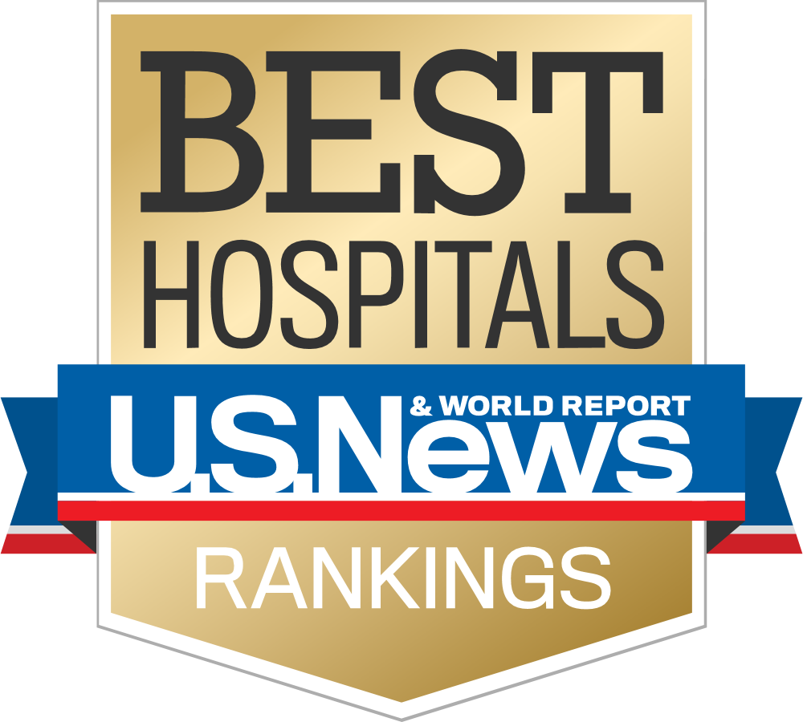
Dana-Farber Cancer Institute
As one of the world’s leading cancer centers, Dana Farber provides patients highly specialized clinical care, expertise, and research.
TOP RANKED
The only cancer center ranked within the top 10 for both adult and pediatric cancer care
HARVARD-AFFILIATED
Principal teaching affiliate of Harvard Medical School
Founding member of Dana-Farber/Harvard Cancer Center
NCI-designated Comprehensive Cancer Center
HIGH PATIENT SATISFACTION
95% satisfaction rating amongst patients
Dana-Farber investigators contributed to 1 in 4 FDA oncology drug approvals
Pathways puts the latest evidence at the point of care and matches patients to our 1,100+ clinical trials
Notable researchers include William Kaelin, MD, 2019 Nobel Prize winner
Profile, a research project launched by scientists at Dana-Farber Cancer Institute, is one of the nation's most comprehensive personalized cancer medicine initiatives.
LEADERS IN INNOVATION
BEST-IN-CLASS OUTCOMES
Significantly higher outcomes/survival rates compared to other NCI-Designated Cancer Centers, academic medical centers and community oncology providers
13

Slide 14
Cancer diagnoses are a major health care cost driver for employers
Cancer claims are only 1% of total claims but amount to 12% of medical cost ¹
50% of cancer-related ED visits and hospital admissions can be avoided by more comprehensive care management²
Cost Discrepancy
Existing Cost Drivers
17% of cancers are misdiagnosed³
High costs due to variations in care and utilization of precision medicine - validation study of Pathways shows 22% lower costs⁴
Excess Cost of Care Due to Access and Variation
Cancer is the number 1 reason for long term disability claims, representing 17% of claims⁵
Long Term Disability
14
Lost Work Time
$139 billion are associated with diminished productivity and lost work time, either for cancer treatment or for caring for someone with cancer.. Employees with cancer are absent 3.8 more days. ⁶
Sources: 1) Nobel, J., Sasser, E., Weiss J., Pickering, L.; Northeast Business Group on Health, “ Cancer and the Workplace: The Employer Perspective,” Oct. 2015. 2_ Panattoni, L., Fedorenko, C., Greenwood-Hickman, M. A., Kreizenbeck, K., Walker, J. R., Martins, R., … Ramsey, S. D. (2018, March 14). Characterizing Potentially Preventable Cancer- and Chronic Disease-Related Emergency Department Use in the Year After Treatment Initiation: A Regional Study. Retrieved from https://www.ncbi.nlm.nih.gov/pubmed/29452549. 3) BWH Pathology, ADCC study. 4) Jackman et al. Cost and Survival Analysis Before and After Implementation of Dana-Farber Clinical Pathways for Patients with Stage IV Non–Small-Cell Lung Cancer 5) Unum 6) Advisory Board
14

Slide 15
Patients and employees feel supported throughout their care journey
First-hand experiences captured by our patients and dedicated clinicians
“As a ten year breast cancer survivor, who also has a friend who has survived a brain tumor for over three years (he wasn’t give more than a year when first diagnosed) Dana-Farber is the elite of the elite. From the Doctors to the Valet parking attendant you will never be better treated. Compassionate, caring, supportive (for your entire family). I cannot say enough about how wonderful EVERYONE is…” Martine, patient
“I once had a referral for a second opinion. I spoke with the patient's wife since he had a brain tumor and difficulty communicating as a result. I guided her through the process and had constant contact with the New Patient Coordinators until things were completely settled.” Tera Feldman, PA-C, Direct Connect
“Dr. Winer and Jen McKenna, MSN have been my medical team for years. They are wonderful & responsible for my surviving breast cancer. Having the results of your mammogram immediately is such a relief. No having to wait several days to get the results is unique to Dana-Farber.” Laura, patient
“I listened to her and we discussed the difficulty of managing life, getting business and life affairs in order and managing emotions. All in all, we spent an hour on the phone. She reached out to me by text a few times and decided to make an appointment.” Tera Feldman, PA-C, Direct Connect
15

Slide 16
Cleveland Clinic

Slide 17
Goal of Cleveland Clinic Clinical Review
IMPROVE OUTCOMES
REDUCE COSTS
OPTIMIZE EXPERIENCE

Slide 18
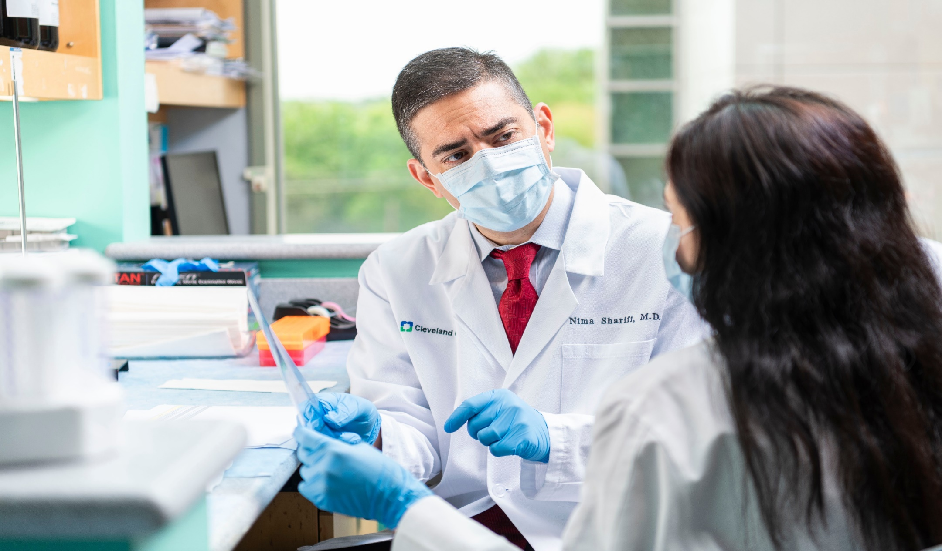
Clinical Review
Cleveland Clinic team reviews medical records remotely to educate and inform on potential treatment options
Ensures optimal diagnosis and treatment plan
Facilitates a timely connection to the right Cleveland Clinic provider
If participant selects Cleveland Clinic for treatment, dedicated team assists with scheduling and customizes itinerary
Offered domestically from Ohio and South Florida facilities
Notes:
Participant presents with a condition that has been diagnosed in their home market and is seeking additional input from a Cleveland Clinic provider
Specialty Referrals obtains all records and images on the participants behalf, and identifies the appropriate provider to review the case
Provider reviews the participant’s medical history, and identifies if care is being optimized in their home market, or if Cleveland Clinic has something unique to offer the participant
This is an asynchronous review, feedback may be provided by the provider or member of the Specialty Referrals team
Participant may choose to schedule a visit with the appropriate provider in order to treat the condition at Cleveland Clinic, or maintain treatment in their home market

Slide 19
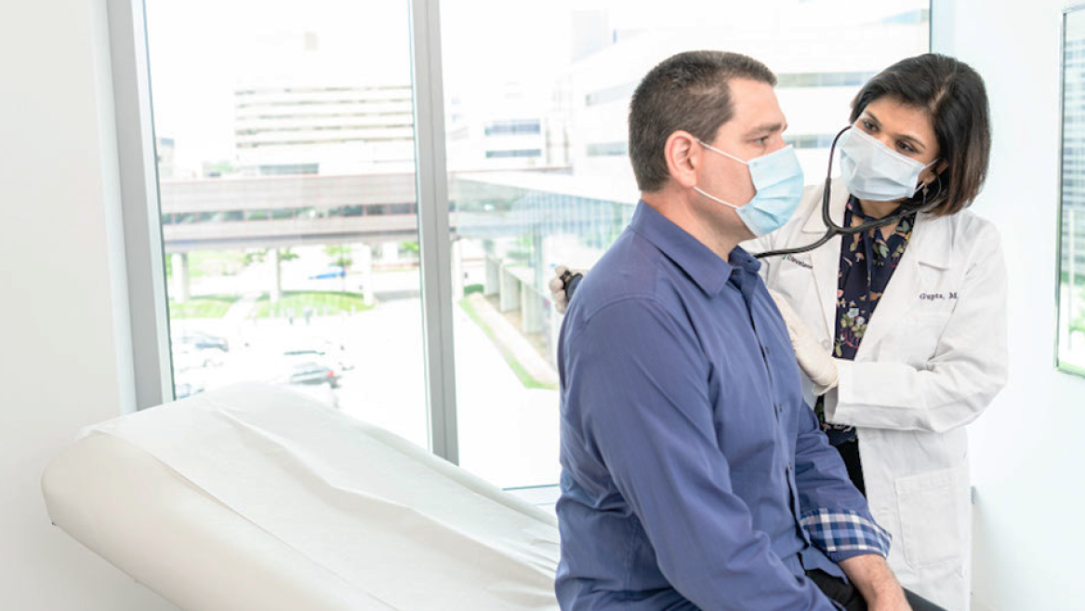
Our Rankings
SPECIALTY AREAS | U.S. Ranking
Cardiology and Heart Surgery | 1
Geriatrics | 2
Rheumatology | 2
Urology | 2
Gastroenterology & GI Surgery | 4
Obstetrics & Gynecology | 4
Cancer | 6
Pulmonology & Lung Surgery | 6
Neurology & Neurosurgery | 8
Diabetes and Endocrinology | 11
Ophthalmology | 11
Orthopaedics | 14
U.S. News & World Report Best Hospitals 2022-2023

Slide 20
Informal Partnerships
Johns Hopkins
Johns Hopkins is among the top 5 hospitals in the country
They are located in Baltimore, MD, which has state-wide price caps, making them highly cost competitive
Top programs include Neurology and Neurosurgery, Psychiatry, Rheumatology, and Ear, Nose, and Throat
Lockton has established a direst contact at Hopkins who can assist us with expedited appointment scheduling
Menninger is a top 10 behavioral health (BH) program located in Houston, TX and is affiliated with Baylor College of Medicine
They have an innovative approach to complex behavioral health conditions. Visits are typically 5 days in length where the member sees multiple subspecialists in both BH and other related medical conditions (e.g. neurology)
Upon follow up, members are connected with a Menninger affiliated BH specialist in their local market for continuity of care
Due to the innovative nature, Menninger is OON on most health plans; they have agreed to providing a substantial discount on any referrals coming through Lockton
Menninger Clinic

Slide 21
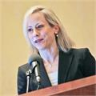
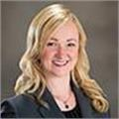
Complex Claims Referral Team
Dr. Christine Hale, MD, MBA
VP, Clinical Consulting
Rachel Hargrove, MBA-HCM
VP, Clinical Practice Lead
Manny Phommahaxay, RN, BSN
Senior Clinical Consultant
Gabriella Elliott, MS HPM
Clinical Operations Administrator
Please direct all referrals and program questions to CCUMD@lockton.com

